Slide 1

Homework 4 cisc INC / DEC / NEG / COM
Steve Gillet

Slide 2
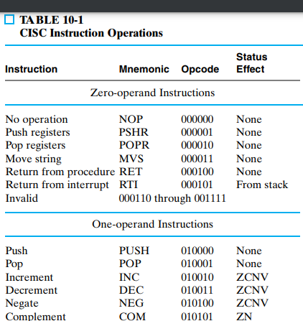
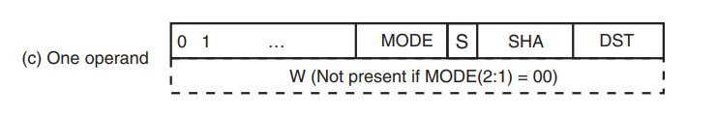
Instruction Format
Opcode: 010010

Slide 3
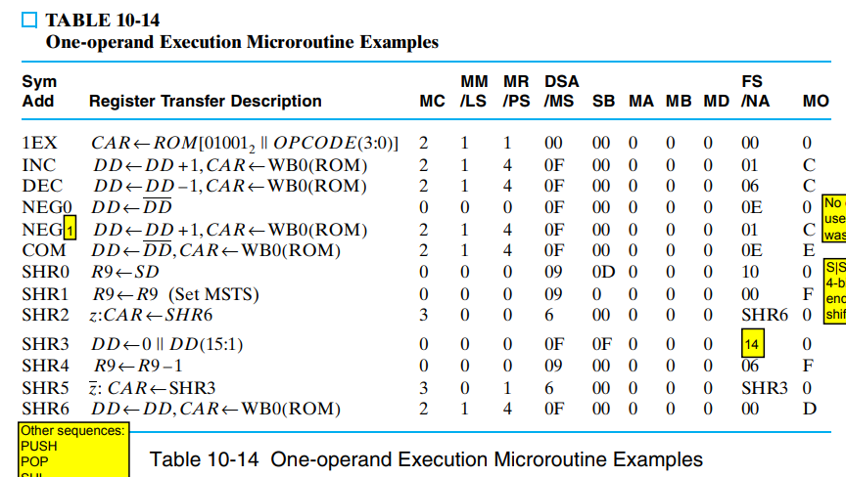
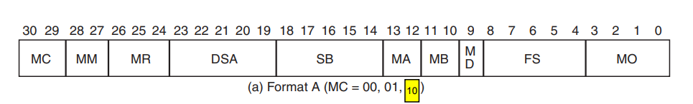
Microinstruction Format
Microinstruction:
MC | MM/LS | MR/PS | DSA/MS | SB | MA | MB | MD | FS/NA | MO
2 | 1 | 4 | 0F | 00 | 0 | 0 | 0 | 01 | C
MC | MM/LS | MR/PS | DSA/MS | SB | MA | MB | MD | FS/NA | MO
10 | 01 | 100 | 01111 | 00000 | 00 | 00 | 0 | 00001 | 1100

Slide 4
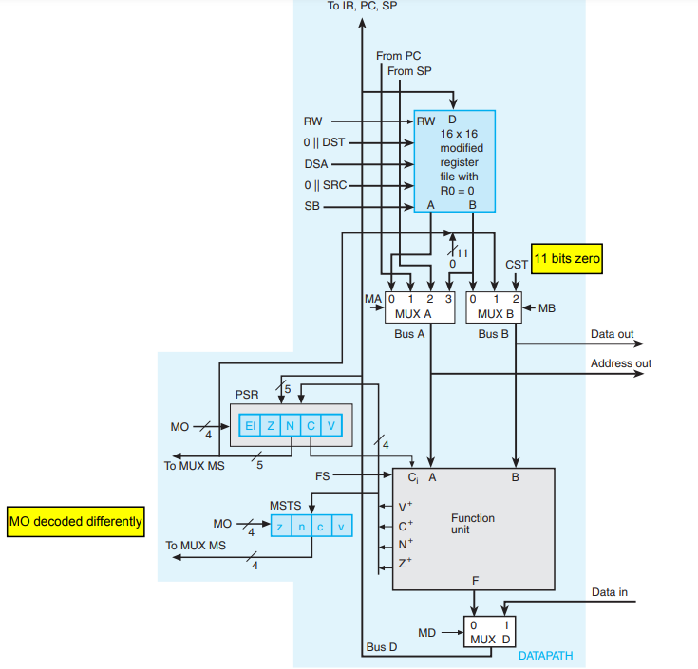
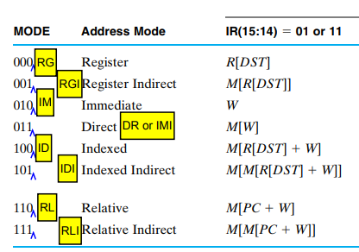
MC | MM/LS | MR/PS | DSA/MS | SB | MA | MB | MD | FS/NA | MO
10 | 01 | 100 | 01111 | 00000 | 00 | 00 | 0 | 00001 | 1100
Addressing Mode
IR First Two of Opcode
Opcode: 010010

Slide 5
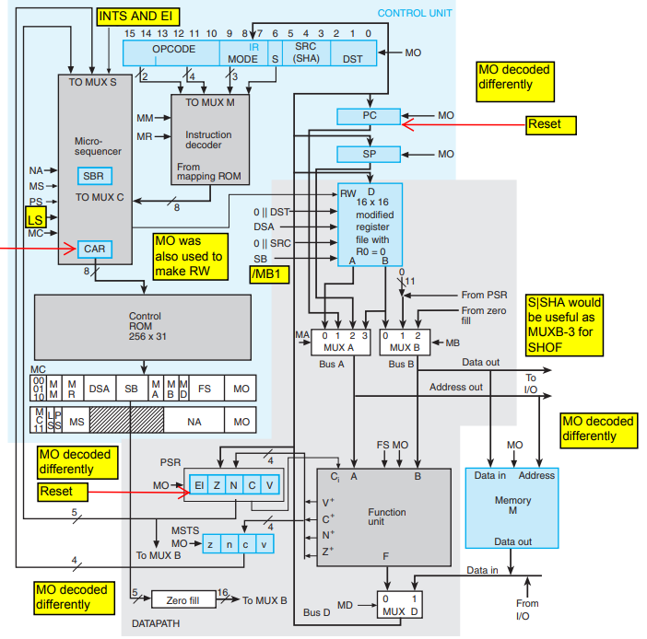
MC | MM/LS | MR/PS | DSA/MS | SB | MA | MB | MD | FS/NA | MO
10 | 01 | 100 | 01111 | 00000 | 00 | 00 | 0 | 00001 | 1100

Slide 6
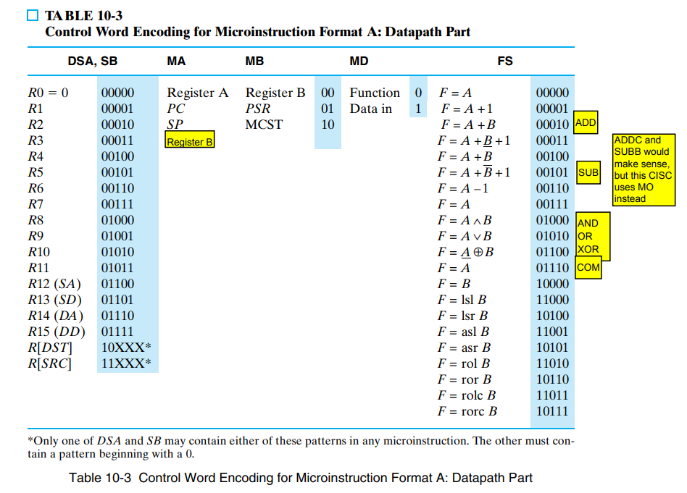
MC | MM/LS | MR/PS | DSA/MS | SB | MA | MB | MD | FS/NA | MO
10 | 01 | 100 | 01111 | 00000 | 00 | 00 | 0 | 00001 | 1100
B Address
Destination and Source Address

Slide 7
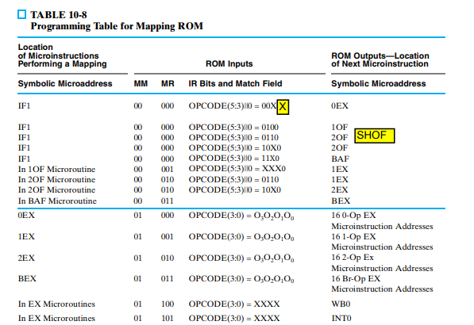
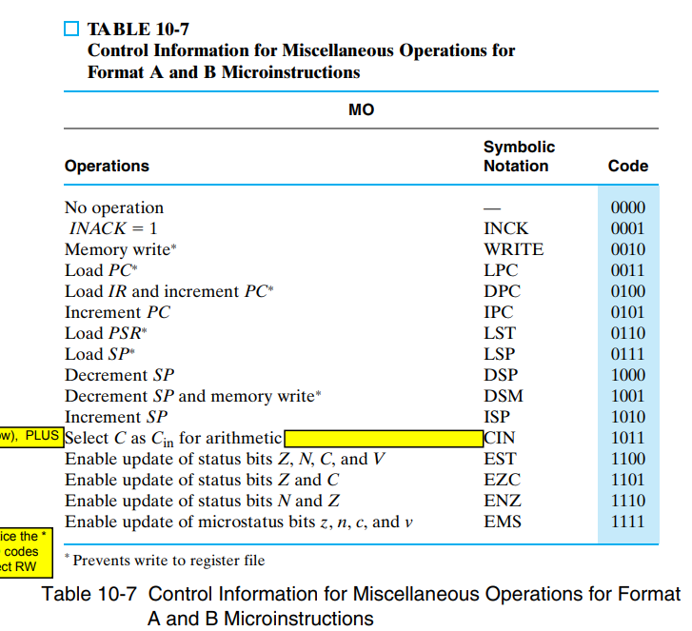
MC | MM/LS | MR/PS | DSA/MS | SB | MA | MB | MD | FS/NA | MO
10 | 01 | 100 | 01111 | 00000 | 00 | 00 | 0 | 00001 | 1100

Slide 8
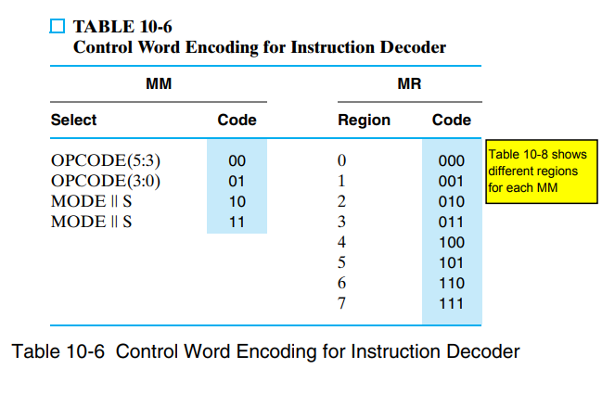
MC | MM/LS | MR/PS | DSA/MS | SB | MA | MB | MD | FS/NA | MO
10 | 01 | 100 | 01111 | 00000 | 00 | 00 | 0 | 00001 | 1100

